Slide 1
Systems Administration

Slide 2
Subject objectives
This subject will cover the practical and theoretical aspects of system administration. The various resource areas which have to be managed will be discussed and examined, and the possible methods of monitoring and controlling them in various systems will be investigated.
The features unique to both single processor and networked systems will be investigated.

Slide 3
Some of the manageable components
Computer System components
Operating Systems.
File System technologies.
Network technologies.
Services (e.g. authentication, Email,)
People and business relationships

Slide 4
The following objectives apply
Identify the manageable components of a typical system.
Demonstrate an understanding of the steps to follow when a system being managed grows and changes with time.

Slide 5
Recommended readings
I am using two main texts in my preparation of lectures:
NEMETH E, SNYDER G, SEEBASS, HEIR TR, Unix Systems
Administration Handbook, 4th ed, Prentice Hall. (There is also one on Linux).
LIMONCELLI T.A., HOGAN C, The Practice of Systems and Network Administration, Addison Wesley Press

Slide 6
Lecture schedule (subject to variation)
Lecture
Topics
Lecture 1
Subject overview,
Introduction to systems and systems administration
Lecture 2
Basic scripting and shell
Lecture 3
User and group administration
Lecture 4
Storage administration and the filesystem
Lecture 5
TCP/IP networking
Lecture 6
Network management
Lecture 7
Security

Slide 7
Who is a systems administrator?
Drink lots of coke and pizza?
Likes playing solitaire?
Devoted family man?
Business savvy?
These are some traits for sure based on experience but they are generally technical in their background, are able to effectively manage people and have a good understanding of business value.

Slide 8
Who is a systems administrator?
A system administrator is a person who manages one or more computer systems.
In some cases administrators have close relationships with
Database administrators
Network administrators
Security administrators
Web administrators
Computer operators

Slide 9
What is a system?
A computer system is any system running an operating system and capable of providing services to a user base or other hosts.
In this course operating systems discussed will be multi-user and enforce security. They are also configurable and tunable to an extent.

Slide 10
The role of the systems administrator
The role of a system administrator is to maximize a system:
Reliability
Integrity
Security
Performance
Efficiency
Ease of use
Order

Slide 11
Reliability
Reliability is a measure of the percentage of time a machine, service and network is usable by the respective user base.
User perception of reliability may not match measurable indicators.
Common services such as mail, web and file sharing suffer from this ‘perception’ problem.

Slide 12
In some environments certain levels of reliability MUST be achieved.
Reliability and service level agreements (SLA’s) go hand in hand.

Slide 13
The easiest measure of reliability is uptime which shows how long a system has been up.
It should be noted however that even though a system is up - it may be inaccessible for a number of reasons e.g. no network connectivity.
Measuring service and network reliability is similar.

Slide 14
It is common practice to install monitoring solutions such as nagios (formerly netsaint) (www.nagios.org) and Cacti (www.cacti.net) to monitor services such as POP/IMAP, HTTP and FTP. Other examples include HP OpenView, StatSeeker, CiscoWorks.
Such tools can be used to monitor networks too and provide an indication of reliability.
Some integrate with SNMP and/or use Shell Scripts

Slide 15
Four 9’s = 99.99% = 52 minutes downtime per year. Five 9’s = 99.999% = 5 minutes downtime per year.
In the case of Five 9’s a single crash/ reboot would destroy the reliability requirement.
This measure usually does not include scheduled downtime.

Slide 16
Integrity
Integrity is the degree to which data stored on a computer system can be trusted not to be lost or damaged.
Integrity is largely effected by;
Storage (file system) design e.g. disk failures.
Administration procedures e.g. backup.
Protocol and hardware design e.g. security

Slide 17
It is harder today for administrators to ensure integrity of data - this is largely due to;
The sheer amount of data being stored.
Complex systems interactions.
Bugs and other problems in software/hardware from vendors.
The list goes on.

Slide 18
A number of solutions exist to help ensure integrity e.g;
Bacula www.bacula.org
Amanda (The Amanda Backup Program)
www.amanda.org
Commercial offerings such as Legato, Tivoli etc.
TripWire (Filesystem checksum tool) www.tripwire.org
However preserving the integrity of data is largely a procedural problem where we use the tools above to get it implemented.
First rule of thumb with system administration is tools are useless without procedure or policy.

Slide 19
Security
As you know Integrity and Security go together.
Security is the degree to which data stored or in transit through a computer network can be relied upon not to be;
Destroyed
Altered
Disclosed to unauthorized parties.

Slide 20
Security is effected by procedures and policy.
For example High Security often means Lower Useability for the user. This in turn effects work flows and procedures in the organisation.
Administrators need to understand this -- it is often their job to help design and/or advise on this.

Slide 21
Security can be achieved through a number of network and host based technologies.
Excellent examples of such technologies include snort (Open Source Network Intrusion Detection System) www.snort.org
There are even tools to assess how vulnerable you are e.g. Nessus.
Check out http://sectools.org/ for a listing of them all.

Slide 22
Performance
From time to time the following are said;
Email is really slow . . .
My computer is not very responsive.
Moodle and SOLS run like a dog.
Administrators are responsible for this as well.

Slide 23
Within some set of constraints, systems should run as efficiently as possible and as fast as possible.
Performance can be improved through
Capital expenditure
Procedures and Policies
Users

Slide 24
It should be noted that performance is typically associated with networks and machines which in turn effects user services. Again the sheer complexity of modern systems makes it difficult to get the best performance out of everything.
Things that influence performance include;
Underlying hardware.
Operating System.
Software design and bugs in software.
Tuning of operating system.
Administration and End User practices.
Never fall into the habit of saying a bigger box or faster network will solve the problem.

Slide 25
Efficiency
Systems should be managed in a way which maximizes the productivity of the administration staff.
Administration staff should not have to worry about ‘small’ things but well that never really happens.
This aim OFTEN conflicts with the other aims of an administrator.

Slide 26
For example:
Centralizing a service may make it easier to administer but it may also have a detrimental effect on performance.
Automating account creation may be efficient but can also influence security and integrity if not done correctly.
It is very hard to balance efficiency with anything else.

Slide 27
Ease of Use
Ease of use is the degree to which a system allows the user base to perform their tasks in the way they desire.
This is affected by policies and procedures

Slide 28
Consider the following scenario;
As users wish to change their password so they instinctively go for their car registration number.
Unfortunately the system administrators have rules on passwords.
The user cries that this system is NOT intermittently easy to use.

Slide 29
The problem with ease of use is that it conflicts with what the administrator tries to do. Areas where the conflict largely occurs are;
Security
Performance
Integrity
People with disabilities have specific usability requirements that SAs are required to deal with (see Legal). Ensuring accessibility features are available on all devices including phones and photocopiers. Specific support may need to given to assistive technologies (hardware such as screen readers and software such as Dragon Dictate)

Slide 30
Again it is really hard to balance ease of use because administrators have to work within the bounds of organisational policies and procedures.
An administrator can hopefully influence these but in some organisational settings it is near impossible.

Slide 31
Order
Order is the degree to which the layout, operation or management of a computer system conforms to a set of regulatory policies or guidelines.
For example consider an ISP and how they need to adhere to the Broadcasting Services Amendment (Online Services) Bill 1999 (originally from Broadcasting Service Act 1992).
Other acts include Suicide Related Materials Offences Act 2006, Copyright Legislation Amendment 2005
You need to think carefully how these laws will affect you and your processes.

Slide 32
Company policies are often used to ensure compliance with these laws (user agreements, privacy policy, intellectual property policy and so on)
There are other areas of policy such as
ethics
equal opportunity (gender, ethnic origins, sexual orientation, people with disabilities)
harassment bullying

Slide 33
A system administrator would typically have these skills
Programming
Administrators will be expected to cut code from time to time. The code will typically be small programs either written in C or an interpreted language like Perl.
Systems
Typically administrators have a strong knowledge of operating systems, systems, services and even protocols. Some administrators know RFC numbers by heart.
Support
Support is fundamental to being an administrator. You need to be able to diagnose and fix problems.

Slide 34
You can expect administrators to do these tasks
Install hardware.
Install disk, raid arrays, tape, memory.
Install of a cluster.
Install and maintain software.
Install operating system
Install applications either binaries or compiles.
Set and maintain configurations.
Manage users and profiles.
Patch and update operating system.
Configure services as requirements change.

Slide 35
Capacity Planning and Performance Tuning.
Tune the operating system to perform with certain applications correctly.
Evaluate resource requirements such as storage, CPU, memory and networks.
Evaluate requirements for infrastructure environments.
Monitoring the systems.
Diagnose and fix problems.
Yes administrators must do a degree of end user support, application support and systems support.
Maintain or increase knowledge and skills.
Evaluate and recommend products.

Slide 36
Maintain local documentation.
What happens if the administrator gets hit by a bus?
Write procedures and policy.
Acceptable use policy.
Security policy.
Specific resource policies.
Disaster recovery plan.
Administration policies and guidelines.
Enforcement and arbitration.
Include executing policies e.g. performing backups and executing audits in accordance with security policy.
Advise and educate users and managements.

Slide 37
Hardware
As a SA you need to understand hardware...
The reason for this is because hardware forms the basis of all services.
Your software will talk to hardware AND you will have constraints imposed on you by the hardware.

Slide 38
Hardware components
The following are the components that make up a modern day computer system.
CPU;
Memory;
Cache(s);
Busses; and
Disk (Secondary Storage).

Slide 39
Major components
Memory (RAM, ROM, DRAM)
Secondary Storage
Devices
Bus
Cache
CPU
CPU

Slide 40
CPU
A particular CPU type is an implementation of an architecture.
The architecture describes how the instruction set and data work internally to the CPU.
The same type of CPU may run at various speeds either internally or externally.
Each clock cycle executes an instruction

Slide 41
Examples of architectures include:
Sparc
– x86 and x86-64
PowerPC
Even more foreign architectures including MIPS, Alpha
Some implementations are:
UltraSparc T3, UltraSparc 1,2,3
Core Duo, i5, i7
PowerPC

Slide 42
Spend time investigating features of Intel Core microprocessors….
https://en.wikipedia.org/wiki/Intel_Core
Choose a processor type and start a new page add information.
Clock speeds are influenced by the architecture. Higher speeds are more difficult to engineer so are more expensive

Slide 43
CPU execution model
The CPU basically, fetches, decodes and executes instructions (known as the instruction cycle). These instructions are typically located in primary memory (could be mapped in by a file)
The CPU has a number of registers which are used to hold this data whilst in execution, e.g.,
Program Counter: Contains the memory address of the next instruction to be fetched.
CPU register: results of one instruction can be written to an internal CPU register for quick access by the next instruction

Slide 44
Reduced Instruction Set Computing VS Complex Instruction Set Computing
RISC and CISC are design philosophies for architectures. They exert considerable influence on implementations.
Generally speaking the aim of RISC is to reduce the number of instructions or the complexity of instructions. This improves the usage of registers and reduces bottleneck manipulating memory

Slide 45
CISC machines tend to put instructions in microcode
The downside of RISC architectures however is the compilers must be smarter - more effort is needed to produce the same results in code.
RISC machine manufactures tend to be uncompetitive in the market against larger manufacturers such as Intel commonly developing CISC machines.
x86 is primarily a CISC machine and this is unlikely to change.
Some argue that improved manufacturing techniques have eroded the argument for RISC machines.

Slide 46
Instruction-level parallelism
CPUs typically have multiple Fetch Execute Decode Units today. So whilst one unit is executing instruction N it may be decoding instruction N+1 and fetching instruction N+2. This organisation is called a Pipeline.
Superscalar CPU’s have grown. In such a model there are multiple execution units i.e. floating point and integer arithmetic units.
Multiple instructions are fetched and decoded at once (via pipelines) and then dumped into a buffer till they can be executed. When an execution unit is free it looks in a buffer for an instruction it can handle.

Slide 47
Task-level parallelism
We tend to run multiple programs at once. A running instance of a program is called a process.
CPU’s run multiple programs in a concurrent fashion by doing what is known as context switching.
When a context switch occurs i.e. a process stops using the CPU for any number of reasons all the data in the registers must be saved in appropriate control structures.

Slide 48
64bit vs 32bit
This defines the width of words the CPU can get in a single cycle.
Most modern day CPU’s are 64 bit today e.g. AMD K10 Core Architecture e.g. Barcelona and Intel’s Gulftown (i7)
The software decides which mode the CPU runs in.
A 64-bit processor performs best with 64-bit software.
A 64-bit processor has backward compatibility and will handle most 32-bit software.
A 32-bit processor is incompatible with 64-bit software.
Bigger word sizes generally affect precision and physically addressable memory.

Slide 49
Memory
Memory comes in a number of varied capacities, speeds and functionality and must match the machines expectations.
Some machines will restrict the place and mixing of types.
SIMM (Single Inline Memory modules) typically ran at 60ns and were either 30/72 pins.
DIMM (Dual Inline Memory Modules) are modules that are 168/184 pins and can support 64 bit data transfers. Such memory operates at 6 - 10 ns.
SODIMM (Small Outline Memory modules) mostly used in laptops.

Slide 50
Volatile memory and non-volatile memory
Volatile memory is computer memory that requires power to maintain the stored information
Dynamic Random Access Memory (DRAM)
Static Random Access memory (SRAM) such as cache memory
Non-volatile memory is computer memory that can retain the stored information even when not powered
ROM, PROM, EPROM and EEPROM
most types of magnetic computer storage devices

Slide 51
DDR
DDR Random Access Memory (Double Data Rate) is a method for memory access enabling multiple memory access to occur simultaneously.
The memory executes twice for each tick of the memory bus (cycle). Current memory is of the DDR4 form.
The memory is extremely common in modern day personal computers. It comes packaged in DIMMS and has a bandwidth of 17 – 21.3 GB/sec.
DDR5 specification is officially in July 2020.

Slide 52
Cache memory
There are generally 3 types of cache memory in modern computer systems.
L1 Cache is typically built into the architecture of the CPU. For example the early Pentiums have a 16K cache. The PowerPC G5 has a 64K L1 cache.
Typically L1 cache is broken down into two separate caches. One is used to hold instructions and the other to hold data.
In the Sun4m architecture they are both 16kb.

Slide 53
L2 Cache is fast access memory which typically sits between the CPU and main memory. It can range between 256 - 8 Megabytes. This is typically part of the implementation for example i7 can have up to 8Mb Cache.
L3 Cache is typically known as high access memory between the motherboard and CPU.

Slide 54
Cache memory functionality
The idea of cache memory is to store frequently used instructions or data in accessible memory locations.
This is predicted by internal algorithms and prediction in the CPU or operating system cache manager.
The idea is to reduce the amount of time in contention
i.e. going through the bus to main memory to reference an address.

Slide 55
Input/Output Devices
There are various ways in which devices work with the CPU.
Polling - CPU basically polls the device till it has done the operation.
Interrupt - CPU blocks the process and does something else till it receives an interrupt indicating the task has been done.
Direct Memory Access (DMA). The CPU gets a device to do the work i.e. a DMA controller and merely collects the results indicated by an interrupt. The DMA subsystem talks to the hardware and vice-versa to get data in/out of memory,

Slide 56
The Bus
The BUS acts as the interconnect for devices and even other buses it traditionally comprised of a control bus, address bus and data bus.
Most modern chipsets divided the bus into two components these being CPU and Device side. In the Intel Community refer to two terms called north bridge and south bridge.
The north bridge typically plays home to the RAM subsystem and video BUS. South Bridge does pretty much everything else.

Slide 57
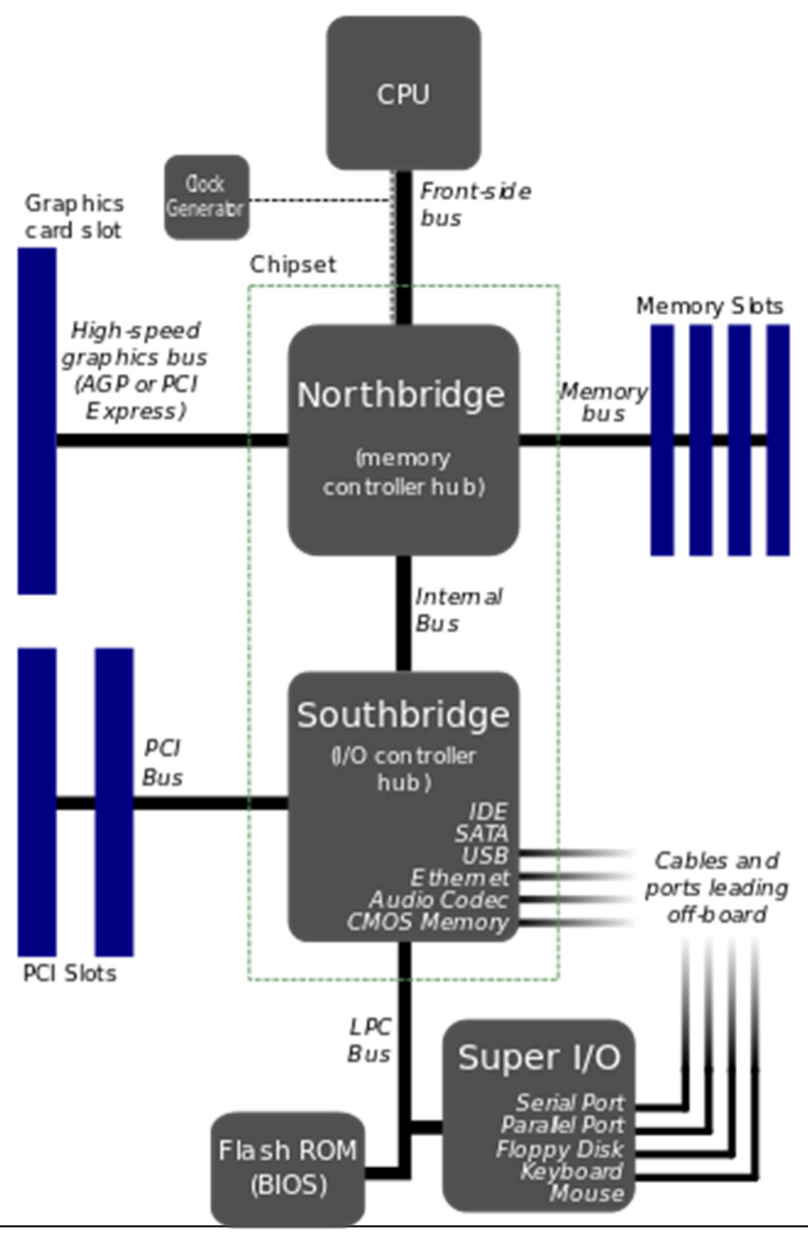



Slide 58
Some common buses used for peripherals
PCI (Peripheral Component Interface)
PCIe (Express)
PCI-X (Extended)
AGP (Accelerated Graphics Port)
VESA
ISA/ Extended ISA (Industry Standard Architecture)
NuBUS (Apple’s proprietary Bus in the late 80’s).

Slide 59
Disk
Disk performance has improved considerably over the last few years.
Performance is largely influenced by;
Transfer Speeds
Seek Time
Rotational latencies
The disk has tracks, tracks from a given position on all platers form a cylinder.
Tracks are divided into small units called sectors.

Slide 60
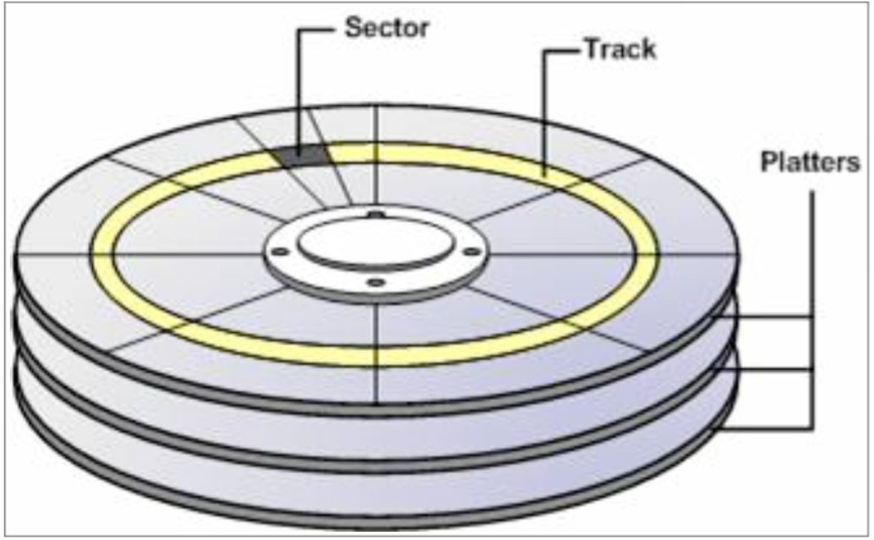

Slide 61
Disks can be broken down into smaller disks often called partitions/slices.
One physical disk can be broken down into any number of logical disks.
These partitions/slices can be used as file systems, swap space or for raw data.

Slide 62
Disc drive Interconnect protocols
Integrated Drive Electronics IDE.
Cheap and nasty - integrated drive electronics. It is the interface. Some people refer to it as ATA.
A better way to think of it is as ATA (Advanced Technology Attachment) is based on a master/ slave model. Defines commands for moving data between host and target.
PATA-33, PATA-66, PATA-100 (Ultra-ATA), PATA-133, SATA-150/300 (the number represent bus rates in MB/sec equivalent to 1.5Gb/sec and 3.0Gb/sec). SATA removes the master slave model and retains the original command set.
There is a version of SATA called eSATA (External Serial ATA).

Slide 63
SCSI
Small Computer Systems Interface SCSI.
Used for a devices such as disks and scanners and capable of supporting a maximum of 7 devices (1 being CPU) per chain.
Expensive.
SCSI I, SCSI II, Ultra SCSI with corresponding bus rates of 5, 5 and 20 MB/sec.
Comes in Narrow, Wide and Fast formats.
Traditional SCSI is parallel.
A modern variation of this however is SAS – Serial Attached SCSI - it is both an interface and protocol. SAS represents a much more complex disk platform. SAS is compatible with SATA.

Slide 64
Fibre Channel (FC)
Serial interconnect for disks over fibre optic cable or copper based media.
High bandwidth transfer rates exceeding between 100Mb/sec - 8Gb/sec.
Typically used in conjunction with other protocols such as SCSI and IP. Such protocols are typically placed on top of FC.

Slide 65
USB –Universal Serial Bus
USB is typically used in commodity hardware and comes in three flavors USB 1, 2 and 3.
In the USB model, one device polls the devices every 1 millisecond.
USB 1 yields a speed of 1.5 Mb/sec.
USB 2 – yields a speed of 480 Mb/sec.
USB 3 – peak of 5Gb/sec (10x speed of USB 2)
USB 3.1 – 10Gb/sec
USB 3.2 – 20Gb/sec
USB 4 – 40Gb/sec

Slide 66
Solid State Drives
Solid-state storage device - uses integrated circuit assemblies as memory to store data persistently - it does not contain a disk or a drive motor.
SSD technology uses interfaces compatible with traditional block input/output (I/O) hard disk drives (ie SATA).
SSDs are more resistant to physical shock have lower access times than HDD. However are more expensive than HDD.

Slide 67
Tape Drives
Traditionally, tape has provided a reliable and cost effective means for mass data storage backup
Often the forgotten child of secondary storage options
Tape is easily located away in a separate location to the organization to guard against a major disruptive events (fire, flood, war, coups etc)
Are tape drives still relevant? Cloud storage is becoming a more attractive option.
Tape still has advantages – can exercise full control over data security

Slide 68
Operating systems
An operating system is an executive manager, it’s the boss.
Four essential managers of every operating system:
The Memory Manager
The Processor Manager
The Device Manager
The File Manager
Networked systems have a fifth manager: the Network Manager
The User Command Interface

Slide 69
User Command Interface
Memory Manager
Process Manager
Device Manager
File Manager

Slide 70
Memory Manager
It checks the validity of requests for memory space
It allocates a portion of unused memory space to legal request
It keeps track of who is using which section of memory in a multi-user environment
It deallocates memory when the time comes to reclaim the memory
Don’t forget, it preserves the space in main memory occupied by the operating system itself

Slide 71
Processor Manager
It decides how to allocate the CPU.
It keeps track of the status of each process.
Once it allocates the processor, it sets up the necessary registers and tables
It reclaims the processor when the job is finished or when the time is up
The Job Scheduler accepts or rejects the incoming jobs
The Process Scheduler decides which process gets the CPU and for how long

Slide 72
Device Manager
It controls the user of devices
It monitors every device, channel, and control unit
It tracks the status of each device
It uses preset policies to determine which process will get a device and for how long
It allocates and deallocates the devices

Slide 73
File Manager
It keeps track of every file in the system
It uses predetermined access policies to enforce restrictions on who has access to which files
It controls what users are allowed to do with files
It allocates the resource by opening the file and deallocates it by closing the file

Slide 74
A simplified example
Let’s say someone types a command to execute a program, what will happen?

Slide 75




Examples of such systems include;
Solaris (now Open Solaris) HP/UX
AIX
DEC Unix (now known as True 64) SGI IRIX (deprecated but still about) SCO (deprecated but still about) Mac OS X
Linux (Centos, Ubuntu, Enterprise Redhat) BSD (Free/Net/Open)
Windows SBS, Server 2008, Server 2003 and even Windows NT.
VMS, Multics, OS360, OS1100,VM (these are older).

